Slide 1
Education vs Income by State
Phil Faulkner, Elton Cummings, Prak Bagavatula, Christian Tourteau

Slide 2
Analysis Importance
Background:
The relationship between income and Education level is well established but remains sometimes poorly understood
Goal:
Use Machine Learning and analyze the relationship between income per Capita on the number of Bachelors percentage and postsecondary degree holding by State in the US
Variables for Exploration:
Per Capita Income (by State), Bachelor's degree Percentage and post secondary percentage (by State)
Period: 2012-2017
Notes:
Aizel

Slide 3
Sources and tools Used
https://apps.bea.gov/iTable/iTable.cfm?reqid=70
https://ncses.nsf.gov/indicators/states/indicator/bachelors-degree-holders-per-25-44-year-olds
Pandas
Matplotlib
Tableau
Scikit-Learn
HTML
CSS
Bootstrap
Notes:
Angelica

Slide 4
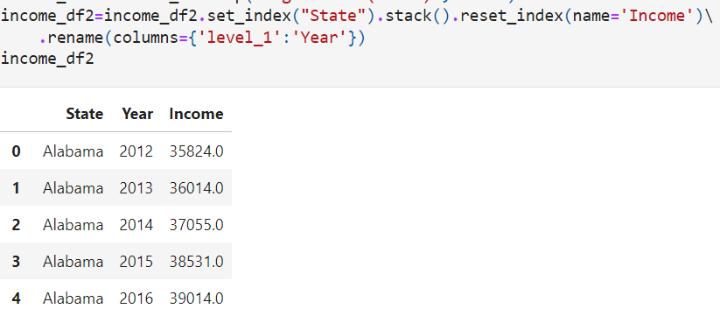
Cleanup
Extract raw data csv files and import to jupyter notebook using pandas to transform the data.
Selected 3 columns from each of the 2 datasets to use in our final dataset for this project.
Notes:
Angelica

Slide 5
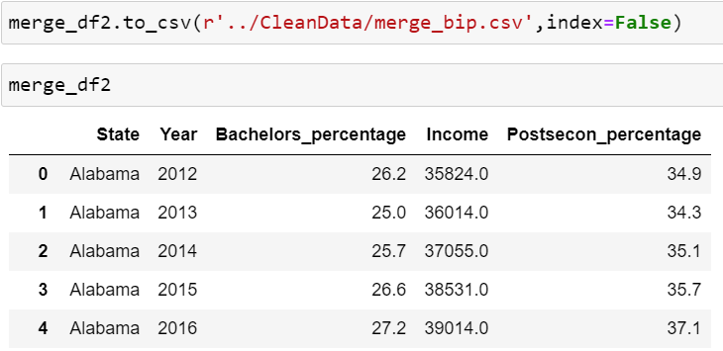
Cleanup
Once the datasets were transformed, we merged all datasets, and exported a merged_results csv file to use it for our analysis and predictions.
Notes:
Angelica

Slide 6
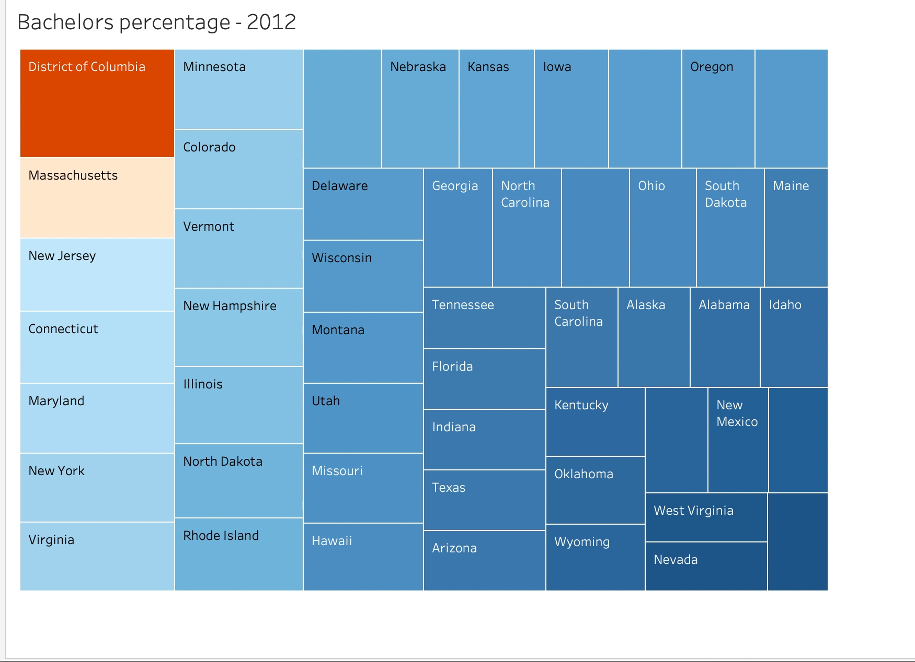
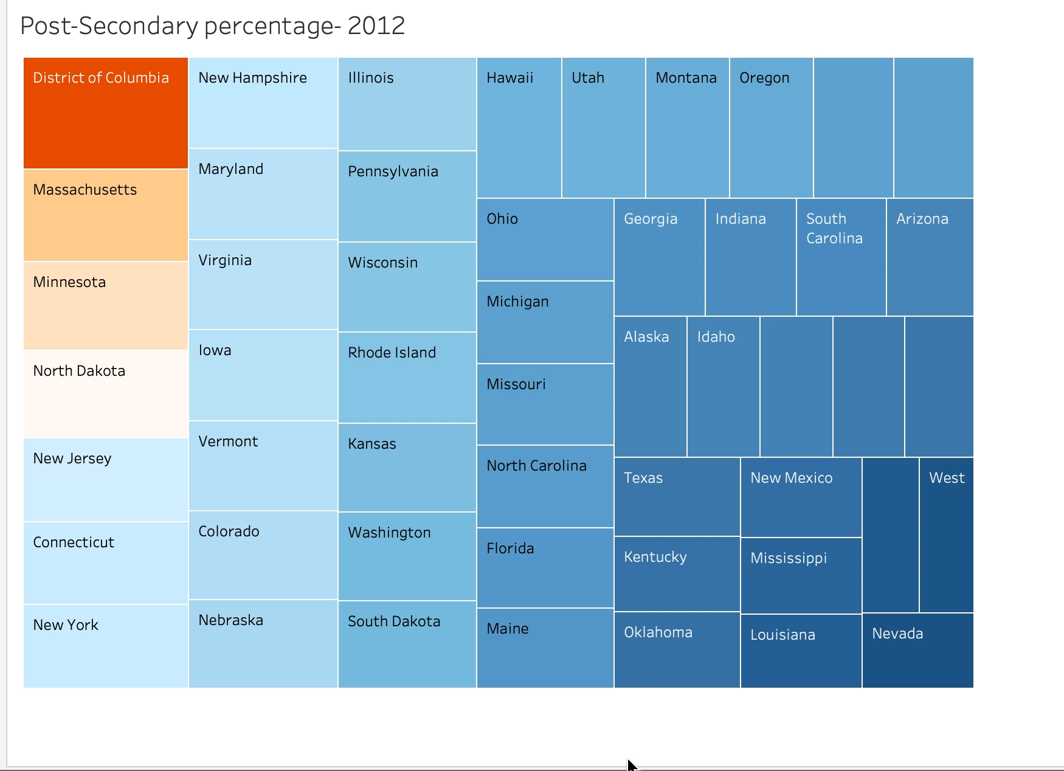
Tableau Data
Used cleanup data ‘merge_bip.csv’ to create Tableau Visualization with a drop down filter by state and year.
Notes:
Yafreisi

Slide 7
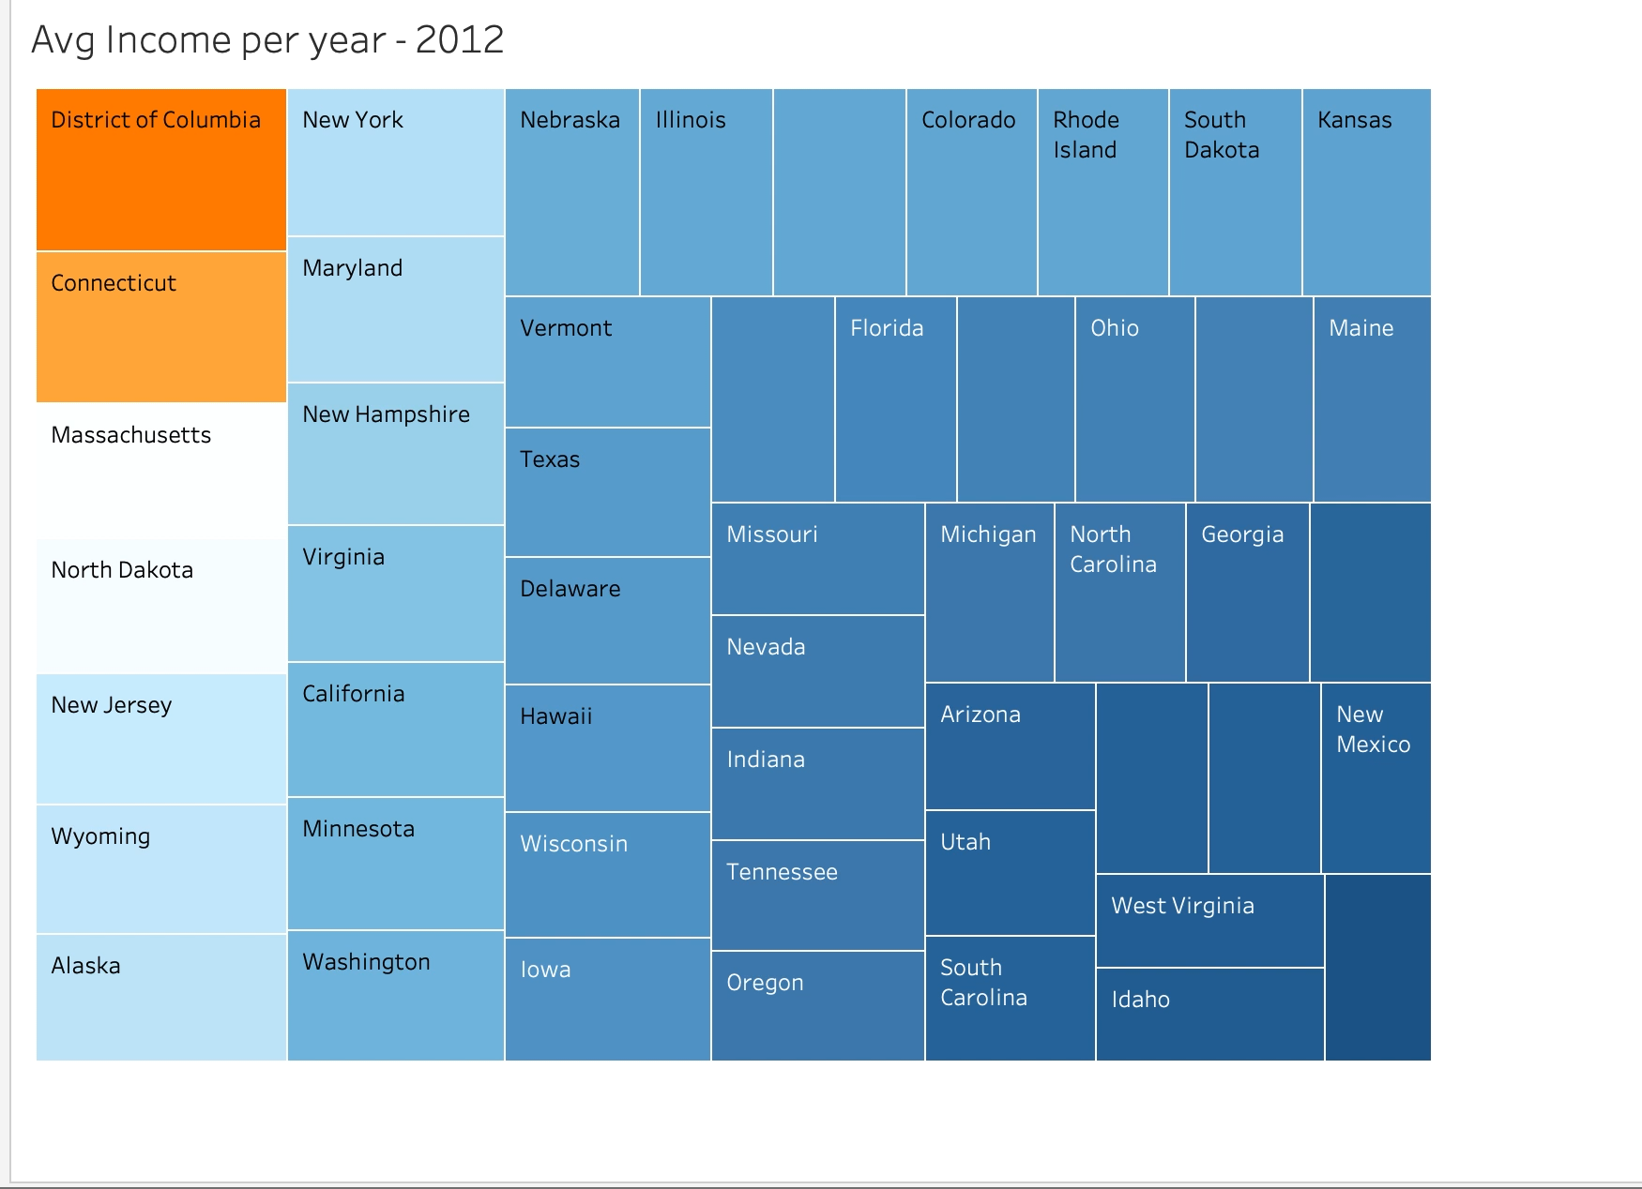
Tableau Data cont’d
Used cleanup data ‘merge_bip.csv’ to create Tableau Visualization with a drop down filter by state and year.

Slide 8
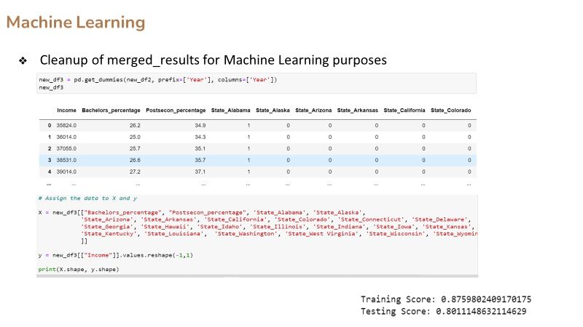
Machine Learning
Cleanup of merged_results for Machine Learning purposes
Prove: Bachelors percentage and postsecondary degre percentage are strongly correlated to the per capita income by State
Notes:
Zohna

Slide 9
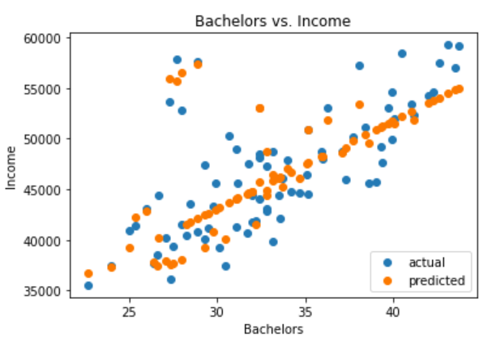
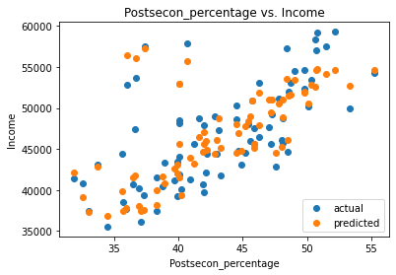
Machine Learning
Bachelors percentage vs Income
-Strong correlation
-Strong positive trend
Postsecondary percentage vs Income
-Strong correlation
-Strong positive trend
Notes:
Zohna

Slide 10
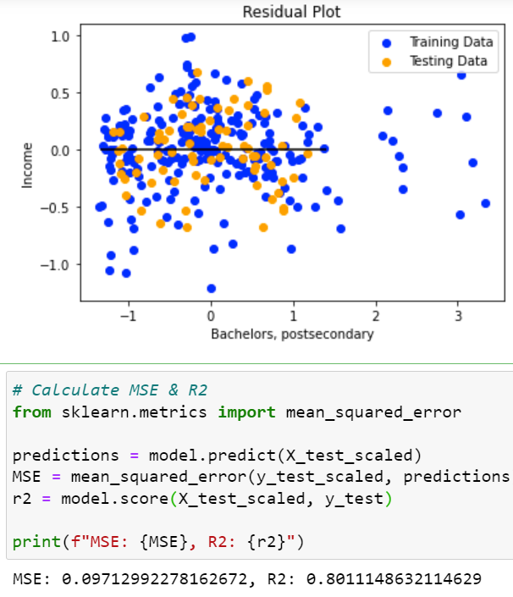
Machine Learning
R2 explains about 80% of the variability of the data around the mean
The mean scored error of .09, close to the desired 0 range
Probabilities of a positive correlation between Bachelors Percentage, postsecondary degree and per capita income are relatively high.
Notes:
Zohna

Slide 11
What we would like to add with further development and time.
•1. Include more years to the data to see how the data might have changed over a larger time frame.
•2. Examine enrollment versus graduation.
•3. Examine countries like the United States and determine the same metrics and compare to the United States.

